Slide 1
Forestview Technologies Project 3: Pizza of Service (POS)
Talha Ali, Mohammad Hoque, Soham Bhavsar, Maher Harkati, Amran Rahim

Slide 2
Introduction
Ease of access
Friendly Interface
Goal of the project

Slide 3
Project Overview
Front End:
Back End:
Data Management
Visuals
Homepage
Customization
Functionality
Responsive
User Interface

Slide 4

Tech Stack
Version Control & Collaboration:
GitHub Desktop
Visual Studio Code IDE
Front End:
HTML, CSS, and JavaScript
Back End:
Python
Tkinter
JSON

Slide 5
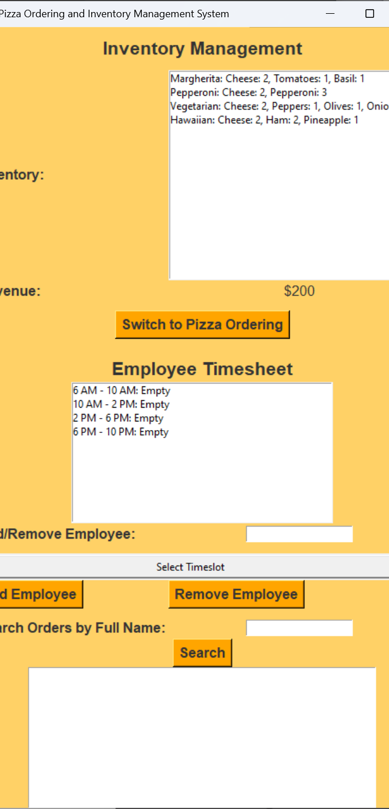
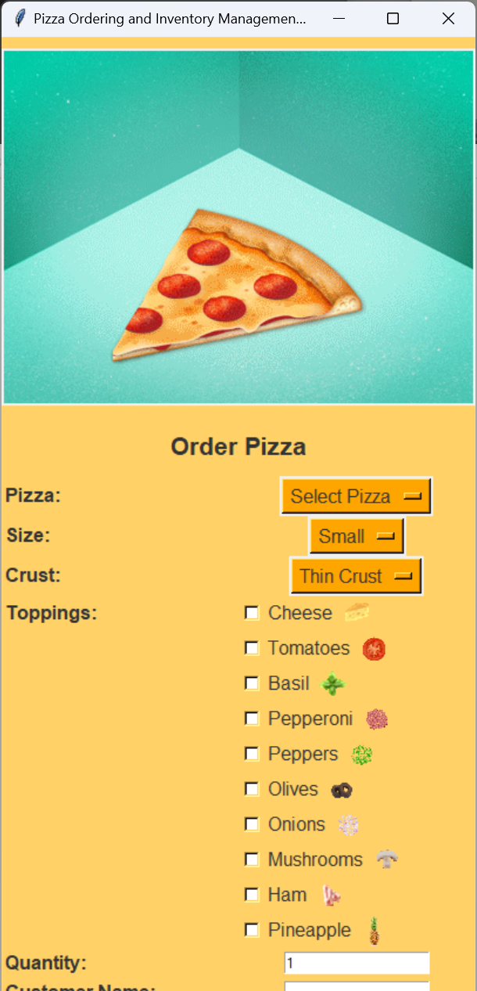
Project Demo

Slide 6
Challenges Along The Way
Back End: UI Pages and Stylizing
Front End: Adding pages for users to acknowledge

Slide 7

Conclusion
Efficiency
Clarity
Teamwork
Success

